Slide 1

Create your own website
George

Slide 2
Today’s session
Basics
Get building
DEploy

Slide 3
Basics 1
Why have a website?
To increase your (business’s/projects’/own) visibility and credibility.
Everybody else has one and it only takes a morning to make.
What should I put on my website?
Contact details, blog, pictures, CV, projects, …
Is making a website hard?
No.

Slide 4
Let’s get building!
Download Visual Studio Code from the website

Slide 5


Basics 2
HTML consists of tags.
h1 = heading 1, p = paragraph
open tag
close tag
open tag
close tag
<h1>Welcome!</h1>
<p>Hello!</p>
content
content

Slide 6
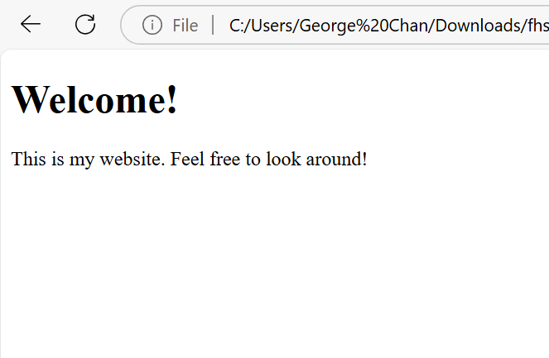
<body>
<h1>Welcome!</h1>
<p>
This is my website.
Feel free to look around!
</p>
</body>
gives
No need to care too much about formatting your code – all extra spaces/lines are removed by the browser.

